Slide 1
Mendelian inheritance in human
&
Chromosomal basis of Inheritance
LIF101A: lecture 4 of 13
Tuesday 8th March 2016
©2005 Lee Bardwell

Slide 2
Genetic Symbols and terms
Factors/genes/alleles
homozygous/heterozygous/recessive/dominant

Slide 3
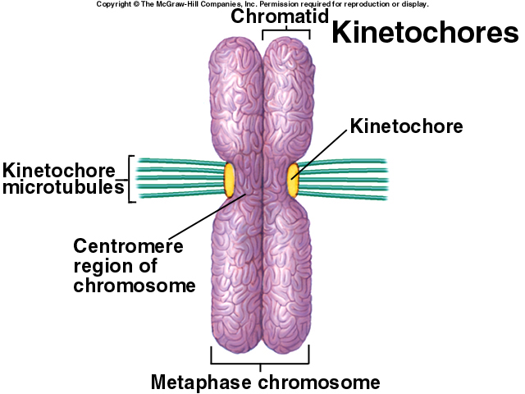
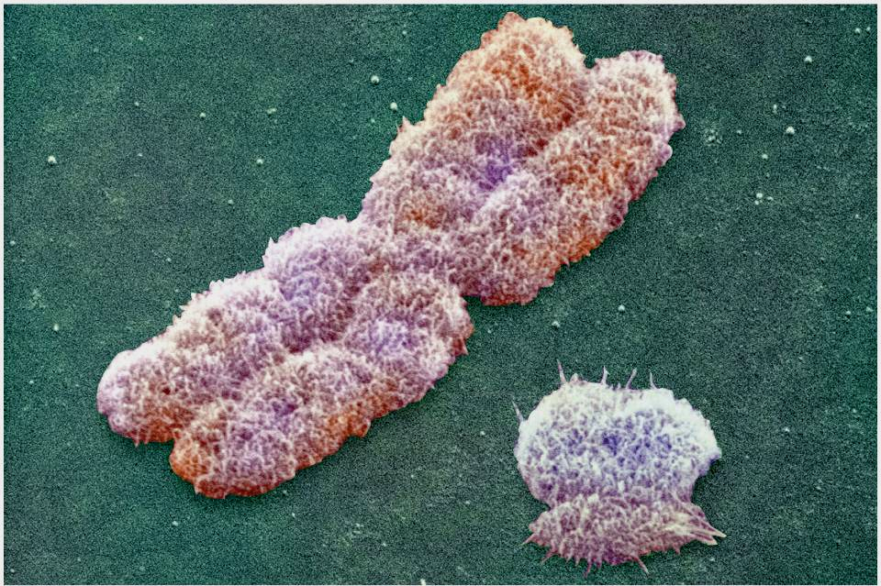
RECAP:
chromosomes : mitosis and meiosis
Are these duplicated? Meaning already replicated
What replicates? Chromosome, DNA or both?
X chromosome

Slide 4
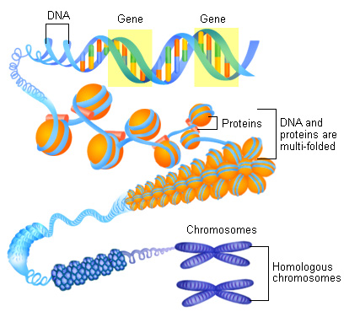
RECAP:
DNA, Chromatin and Chromosome
What is the distinction between chromosome and chromatid?
How many DNA molecules does one chromatid represent?
This is where we see chromosome as discrete entities under microscope

Slide 5
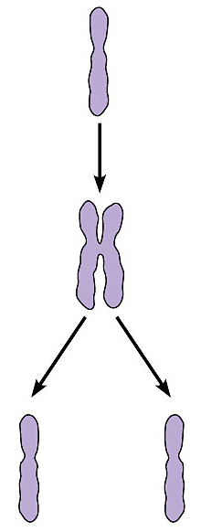
RECAP:
Mother
cell
When the cell divides, the sister chromatids separate
Chromosome
duplication
  Two daughter cells are produced
  Each has a complete and identical set of chromosomes
Centromere
Sister
chromatids
Daughter
cells
Chromosome
distribution
to
daughter
cells
Figure 8.4C

Slide 6
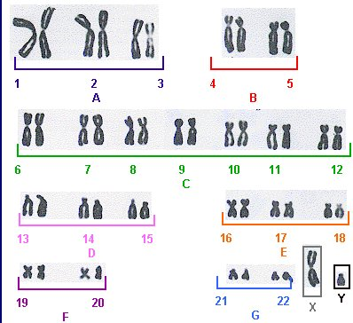
Which one is a chromosome and where are the chromatid?
How do we count chromosome number?
How many ‘sets’ of chromosomes are seen here?
Idea of diploid ‘2n’ and haploid ‘n’ sets
A karyotype (ORDERED ARRANGEMENT) of metaphase chromosomes ( in homologous pairs)

Slide 7
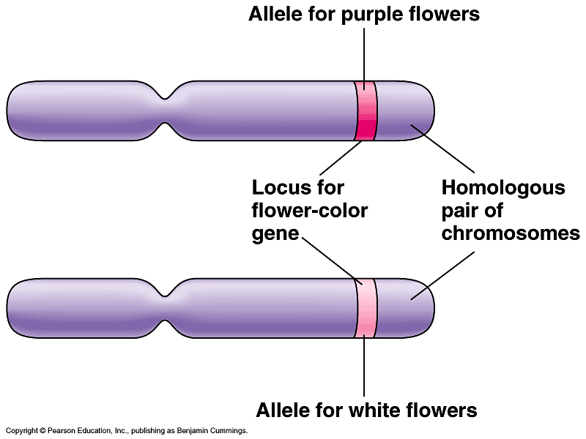
Recap
Chromosomal basis of Mendelian inheritance
Mendel explained inheritance in pea in 1865 – it was not called a law in those days – it was hardly noticed. The physical basis of Mendelian inheritance was clear when chromosomes were discovered and their transmission in somatic cells (by Mitosis) and Gametes (Meiosis) was understood in the early 1900s
Summary of our current understanding

Slide 8
Goals of Pedigree Analysis
Determine the mode of inheritance: dominant, recessive, partial dominance, sex-linked, autosomal etc.
Determine the probability of an affected offspring for a given cross.

Slide 9
Symbols used in pedigree analysis:
Male
Sex
unspecified
Female
Affected
individuals
Mating
Heterozygotes
for autosomal recessive
Parents &
Children:
1 boy; 1 girl
(in order of birth)
Carrier of sex linked recessive
Death
Dizygotic
(non identical
Twins)
Abortion or still birth
Propositus
Monozygotic
(identical
Twins)
Consanguineous
marriage

Slide 10
Pedigree Analysis
Marriage
Normal female
Normal male
I
One these parent was therefore a carrier
1st born
II
Affected
Siblings
Is the mutant allele dominant or recessive?

Slide 11
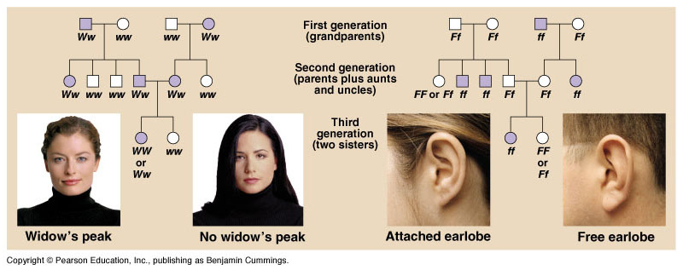
Pedigree Analysis

Slide 12
A Pedigree
Ww
ww
I
1
2
II
1
2
3
4
5
6
ww
ww
ww
Ww
Ww
Ww
III
1
2
3
4
5
6
7
8
9
10
ww
ww
ww
Ww
ww
ww
Ww
Ww
ww
Ww

Slide 13
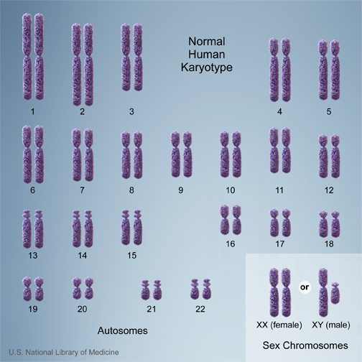
Sex-linked inheritance
The inheritance of genes located on the sex chromosome

Slide 14
Autosomal vs. sex-linked traits
Autosomal traits are caused by genes on autosomes (chromosome 1-22)
  autosomal recessive or dominant traits /diseases
Sex-linked traits are caused by genes on the sex chromosomes (X or Y)
  X-linked recessive or dominant traits /diseases

Slide 15
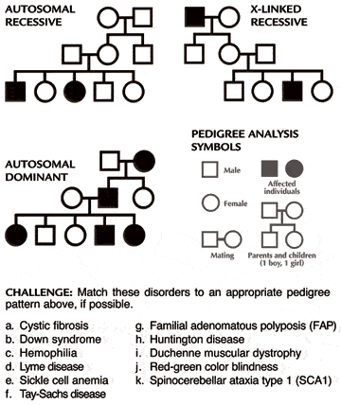
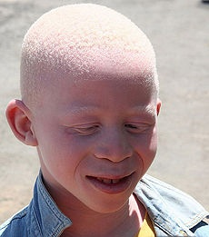
Albinism :
Autosomal recessive inheritance
Why this inheritance is called autosomal?

Slide 16
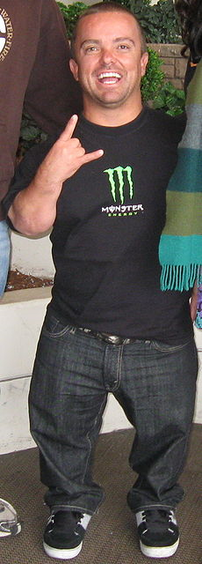
Achondroplasia:
Autosomal dominant inheritence
Why this called autosomal dominant?

Slide 17
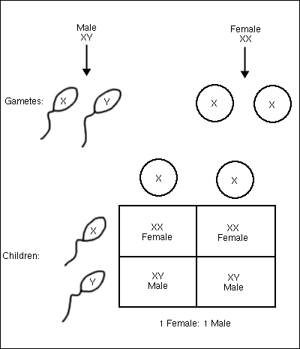
Sex Determination in humans
Parents

Slide 18
In such an inheritance pattern what is the ready sign of sex-linkage?
Father
X_{A}Y
X_{A}
Y
Daughter
XX_{A}
Son
XY
X
Mother
affected
normal
X X
Son
XY
Daughter
XX_{A}
X
affected
normal
X-linked dominant

Slide 19
Female carrier* mates with normal male
X-linked recessive disease
F x M
X_{N}X_{A} X_{N}Y
Sperm
X_{N}
Y
F
X_{N}X_{N}
M
X_{N}Y
X_{N}
normal
normal
Eggs
F
X_{A}X_{N}
M
X_{A}Y
X_{A}
carrier
affected
Half* her daughters will be carriers
Half* her sons will be affected
*on average

Slide 20
Affected male mates with normal female
X-linked recessive disease
F x M
X_{N}X_{N} X_{A}Y
Sperm
X_{A}
Y
F
X_{N}X_{A}
M
X_{N}Y
X_{N}
carrier
normal
Eggs
F
X_{N}X_{A}
M
X_{N}Y
X_{N}
carrier
normal
All his daughters will be carriers
None of his sons will be affected

Slide 21
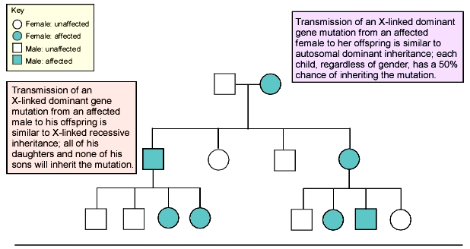
Pedigree Illustrating Inheritance Pattern of an X-Linked dominant mutation

Slide 22
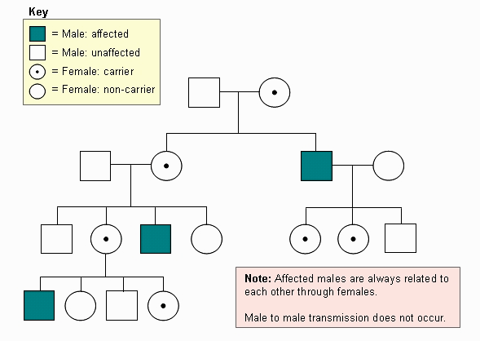
Pedigree Illustrating X-Linked Recessive Inheritance Pattern
Great grand mother
Grand mother
Nani
Grand Uncle
Grand daughter
Uncle (mama)
Nephew

Slide 23
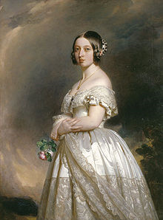
Hemophilia : X-linked recessive
Empress of India 1876
Queen Victoria (1819-1901)
passed haemophilia A
on to many of her descendants

Slide 24
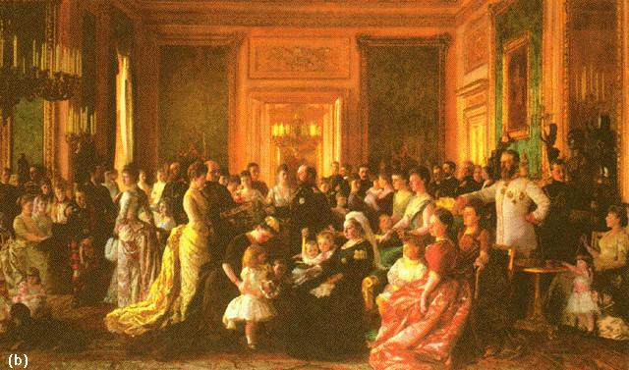
Hemophilia: The Royal Disease
The inheritance of the X-linked recessive condition hemophilia in the royal families of Europe

Slide 25
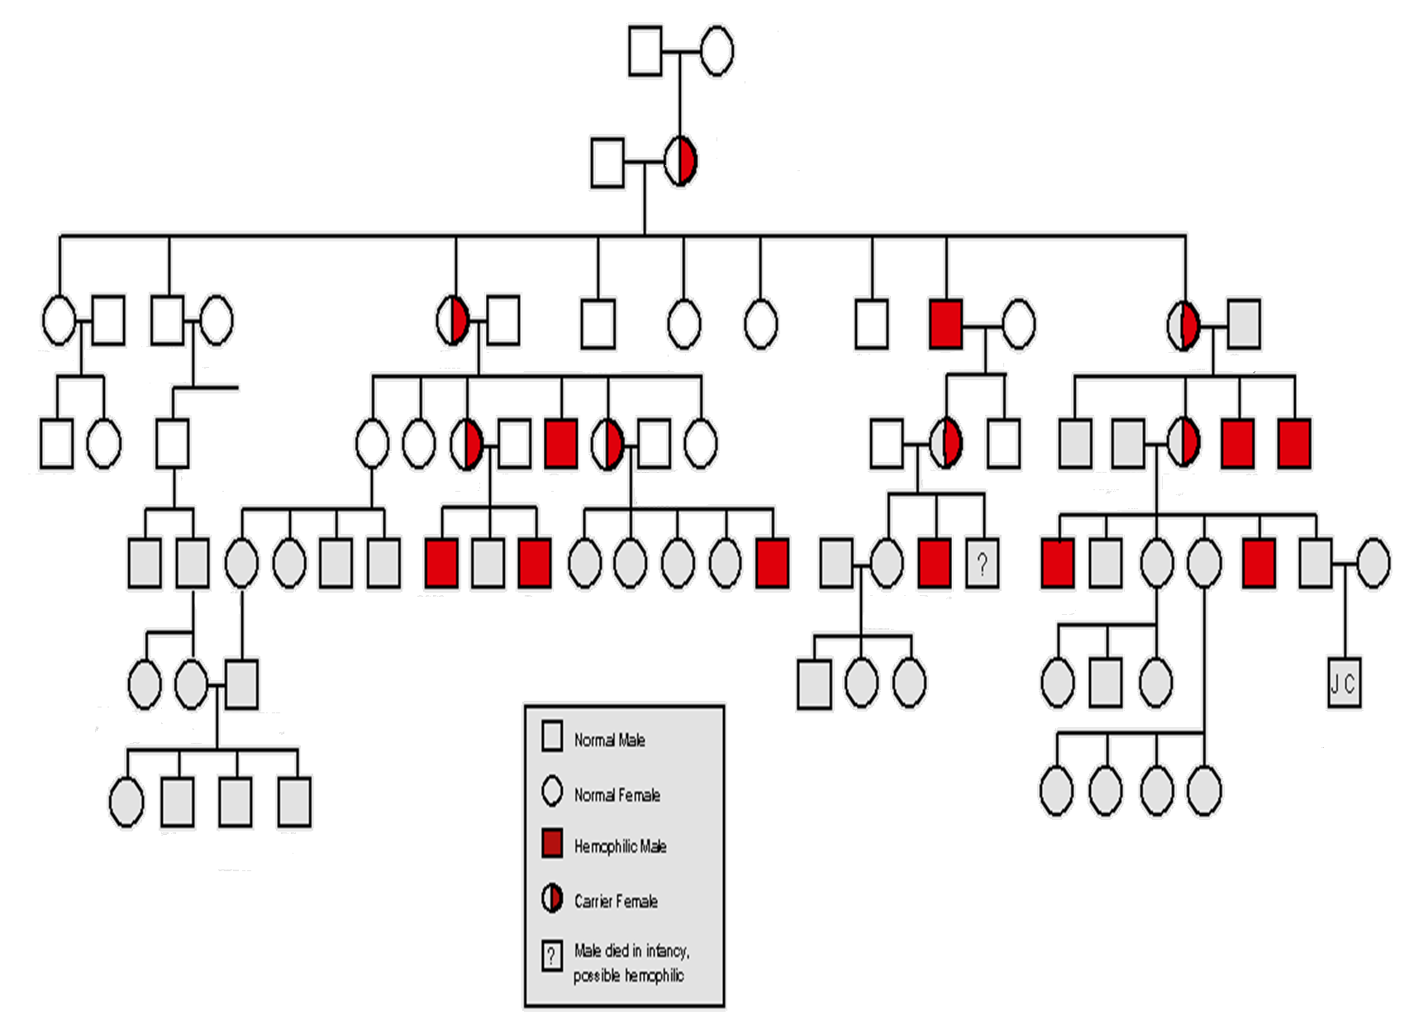
Edward
(Duke of Kent)
Victoria
(Princess of Saxe-Coburg)
Albert
Victoria
(Queen of England)
Alice
Arthur
Victoria
Frederick
Louis
Alfred
Helena
Louise
Leopold
Helen
Beatrice
Henry
Wihelm II
Sophie
George V
Alix
Nikolas II of Russia
Alfonso XII Spain
Eugenic
George VI
Waldemar
Henry
Alexic
Alfonso
Gonzalo
Queen Elizabeth
Prince Philip
Normal Male
Normal Female
Hemophilic Male
Carrier Female
?
Male died in infancy
Possible hemophilic

Slide 26
Some X-linked recessive human diseases
Hemophilia A
Hemophilia B
Red-green color blindness
Duchenne muscular dystrophy
Retinitis pigmentosum (one of many loci)
Lesch-Nyhan Syndrome
Many others

Slide 27
Some X-linked dominant human diseases
Incontinentia Pigmenti
Hypophosphatemic Rickets
Charcot-Marie-Tooth disease
Chondrodysplasia Punctata

Slide 28
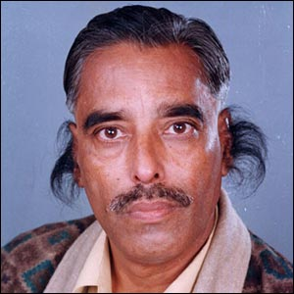

Hypertrichosis pinnae auris : Y-linked
XY
XX
XX
XY
XX
XX
XY
XY
XX
XX
XX
XY
XY
As only males have a Y chromosome, the genes are simply passed from father to son. Every son of the father will be affected. Very few Y-linked disorders are know except infertility

Slide 29
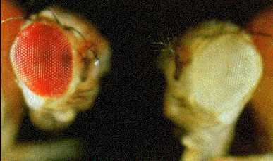
Inheritance of eye coloration in fruit fly, Drosophila:
An example of sex-linked inheritance
Normal Red
Mutant white

Slide 30
First : Observe
No eye coloration : white eyed
Normal eye coloration : red eyed
How do we name the gene and what are its alleles??
Gene name white
Normal Allele : white (+) red pigmentation
Mutant allele : white no pigmentation
Which one is recessive and which one is dominant?

Slide 31
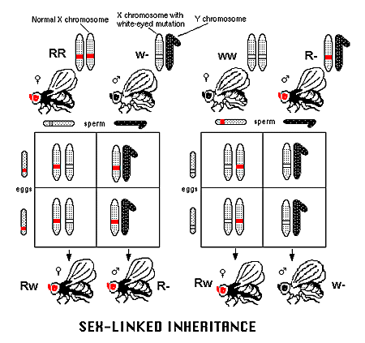
Then test and infer
W
w w
W+
w+w+
w
w+w
w+w
w+w

Slide 32
Problem
A yellow body-colored female fruit fly was mated to a male with normal body color (brown).
All the female progeny were brown (normal) while all the male progeny were yellow. What does this inheritance pattern signify?
Solve this problem

Slide 33
Significance of chromosome numbers in in heritance
What if individual chromosomes do not separate during meiosis? Error in chromosome number

Slide 34
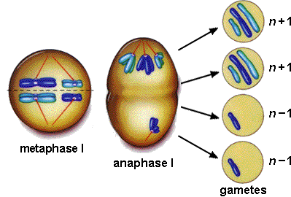
The Culprit: Non-disjunction
Older women are more likely than younger women to evidence chromosome damage and meiotic irregularities

Slide 35
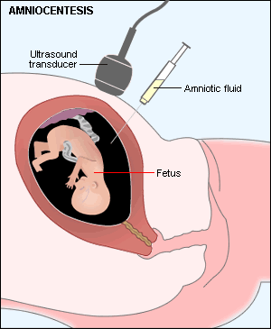
Pre-natal Diagnosis: Amniocentesis
Will it be possible to detect a defective gene by amniocentesis?
Fetal cells present in amniotic fluid are then cultured and analyzed for chromosomes (karyotyping) and other biochemical tests

Slide 36
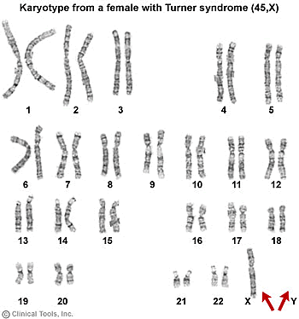
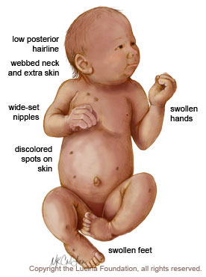
This baby has one X chromosome. Yet it is a female baby. Why?
Monosomy: Turner’s Syndrome: 44+X

Slide 37
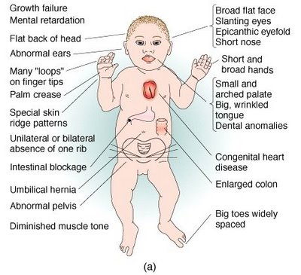
Individual chromosome segregation going wrong during meiosis
Why down’s syndrome does not suggest abnormal sex linked inheritance?
How can errors in chromosomal segregation result in Down’s syndrome?
Trisomy of chromosome . 21: Down’s
Syndrome: 45+XY/45+XX
Other disorders: Trisomy-13 (47:+13), Trisomy-18 (47:+18),
Klinefelter Syndrome (44+XXY), Triple X syndrome (44+XXX), XYY trisomy (44+XYY)

Slide 38


People suffering from Down syndrome can lead a reasonably normal life

Slide 39
Genes and, chromosomes and some interesting facts about our inheritance

Slide 40
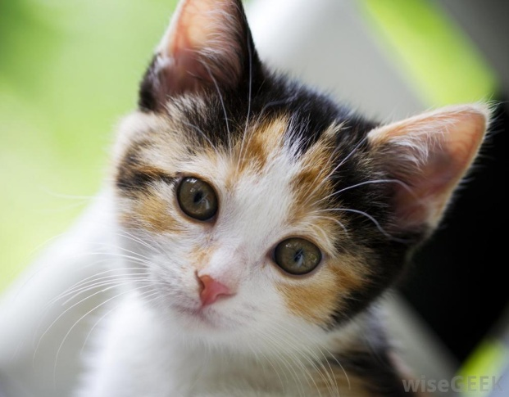
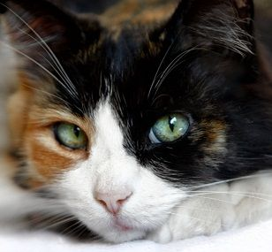
These cats are known as ‘Calico cats’ marked by their patchy coat (fur) coloration . The coloration gene (or fur pigmentation gene) is present on the X chromosome (X-linked)
Coat coloration
in X^{B}/X^{b} cats
B= orange allele
b= Black allele
Notes:
Unlike the gene-poor Y chromosome, the X chromosome contains over 1,000 genes that are essential for proper development and cell viability. However, females carry two copies of the X chromosome, resulting in a potentially toxic double dose of X-linked genes. To correct this imbalance, mammalian females have evolved a unique mechanism of dosage compensation by way of the process called X-chromosome inactivation (XCI), female mammals transcriptionally silence one of their two Xs in a complex and highly coordinated manner (Lyon, 1961). The inactivated X chromosome then condenses into a compact structure called a Barr body, and it is stably maintained in a silent state (Boumil & Lee, 2001).
A prime example of X inactivation is in the coat-color patterning of calico cats (Figure 1). In cats, the fur pigmentation gene is X-linked, and depending on which copy of the X chromosome each cell chooses to leave active, either an orange or black coat color results.

Slide 41

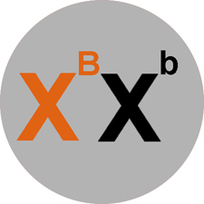

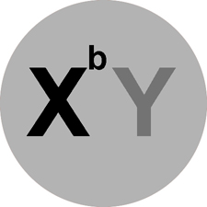
Possible Female genotypes
Possible male genotypes
Notes:
In cats, one of several genes controlling fur color is located on the X chromosome. The gene has two versions, or alleles. One form of the gene codes for orange fur (X^{B}), and the other form codes for black fur (X^{b}). The orange allele is dominant to the black allele. Ordinarily, this would mean that an animal inheriting one copy of each gene (genotype X^{B}X^{b}) should have orange fur. Surprisingly, a female cat heterozygous at that locus (X^{B}X^{b}) will not be orange. Instead, her coat will be a patchwork of orange and black, a condition known as tortoiseshell. Why is she not just orange?
Males, having only one X chromosome, carry only one allele for the orange vs. black fur color trait. The Y does not carry this allele at all, being much smaller and having fewer loci than the X chromosome. The condition of carrying only one allele for a particular trait is known as hemizygosity (from the Greek hemi, meaning "half" and "zygote", referring to the fertilized egg).There are two possible (normal) male genotypes:

Slide 42


However, one of the X chromosomes is randomly inactivated in female cat body cells
Female cell where X chromosome carrying black allele allele is inactivated
Female cell where X carrying orange allele is inactivated
Notes:
In females, expressing double the amount of X-linked gene products, as compared to as the male, is prevented by a process of inactivation of one X chromosomes, such that it can no longer express its genes. At a certain point in the embryonic development of every female mammal (including cats), one of the two X chromosomes in each cell inactivates by supercoiling into a structure known as a Barr Body. This irreversible process leaves only ONE active X chromosome in each cell of the female embryo. Only the alleles on the active (uncoiled) X chromosome are expressed

Slide 43
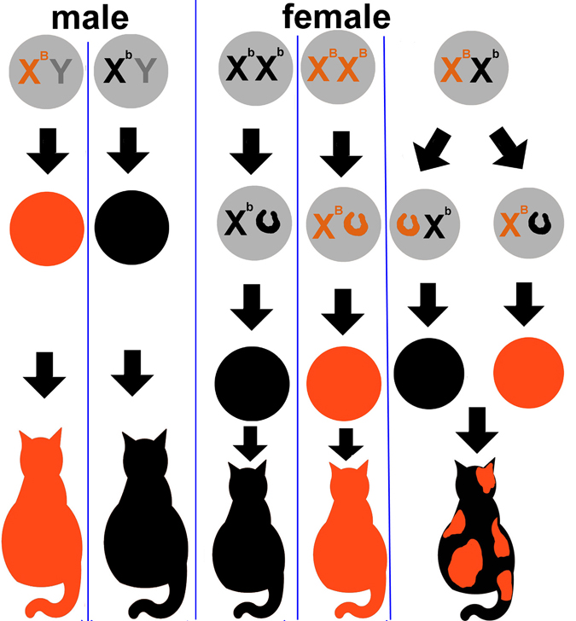
Note the fur/coat coloration in male and female cats
Explain why male cats have uniform coat color
Explain why these female cats have patchy coat color
Explain why these female cats have uniform coat color

